Slide 1
Defense Industrial Base Information Sharing Analysis Center
DIB ISAC
Serving the DIB Community
Presented by
Steve Lines
President, DIB ISAC
March 17, 2018

Slide 2
Why ISAC/ISAOs?
Trusted entities established by Critical Infrastructure/Key Resource owners and operators.
Comprehensive sector threat intelligence analysis aggregation/ anonymization.
Reach-within their sectors, with other sectors, and with government to share critical information.
All-hazards approach.
Threat level determination for sector.
Managing risk through Operational-timely accurate, actionable information sharing.

Slide 3
DIB Community Benefits
Partner with local first responder community before and during crisis events.
Partner with DHS/FEMA NASA International Organizations such as the UK CISP Program.
Conducted Exercises with multiple agencies.
Contract awarded to DIB ISAC from DHS on the NIPP Challenge for DIB ASSIST.
Partner with the Global Institute for Cyber Resilience at Kennedy Space Center to form the International Association of Certified ISAOs (IACI).
Provided Cyber Intelligence from DHS, UK MOD and Industry Canada to Member Companies.
Host daily Cyber Threat Intelligence cross sector calls with the analyst communities.

Slide 4
Cyber Security and the DoD Supply Chain
Helping supply chain contractors in understanding the threat
  Online threat briefings daily for the members.
  Translating the threat and potential impact to supply chain companies
Compliance with EO/PPD directives (both EO 13636 and 13691)
  DIB ISAC designated an Information Sharing Analysis Organization by DHS.
Compliance with DFAR 252.204.7012 Protection of CUI
  Defining steps as outlined in the 800-171 Specific controls in the DFAR to be compliant.
  Assistance in understanding reporting requirements.
  Securing companies once a breach has occurred.

Slide 5
Cyber Security and the DoD Supply Chain
Barriers to compliance
  Monetary.
  Capabilities.
  Responsibilities (Contracting Officers directions vs DPAP Office Program PGI)
  AT&L cannot effectively manage a program of over 100,000 Cleared Defense Contractors nationwide. The program must be managed regionally using existing resources within the contracting community.
  Definition of “Compliance”.

Slide 6
Cyber Threats
Politically Inspired Attacks
  Terrorism.
  Nation State Attacks.
  Destabilization.
  Hacktivism.
Economic
  Identity Theft.
  Blackmail.
  Ransomware.
  Bank Account Attacks (Organized Crime).

Slide 7
Cyber Threats
Social Networking
  Surveillance.
  Cyberstalking.
  Child Pornography.
Legal
  Regulatory Requirements.
  PII, PCI, HIPPA Data Standards and laws etc.
Advanced Persistent Threats (China, Russia, Iran).

Slide 8
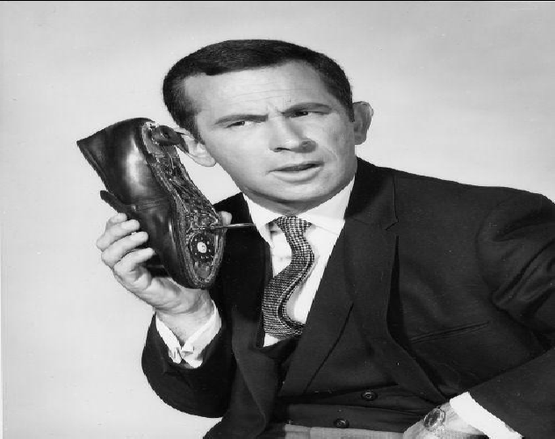
What are the Bad Guys Doing?

Slide 9
Operation Grizzly Steppe
Discovered in October 2016.
Identified as Russian Adversary.
Tenable Report 5-2-18 re: Schneider Industrial Control Systems
  Patched April 2018.
  Many have not applied the patch.
  Allows attacker to take complete control of logic controllers remotely.
Ukrainian ICS attacks
  Used Phishing to steal credentials of users.
  Compromised Systems after conducting surveillance of user activity.

Slide 10
Links in the Security Chain: Management, Operations, and Technical Controls
Risk assessment
Security planning
Security policies and procedures
Contingency planning
Incident response planning
Security awareness and training
Physical security
Personnel security
Certification, accreditation, and
security assessments
Access control mechanisms
Identification & authentication mechanisms
(Biometrics, tokens, passwords)
Audit mechanisms
Encryption mechanisms
Firewalls and network security mechanisms
Intrusion detection systems
Security configuration settings
Anti-viral software
Smart cards
Adversaries attack the weakest link…Our Goal is not to be that link…..

Slide 11

Weakest Link in the Chain
Clem the “Clicker”

Slide 12

Problem Statement
SECURING THE U.S. ELECTRICAL GRID
UNDERSTANDING THE THREATS TO THE MOST CRITICAL OF CRITICAL INFRASTRUCTURE, WHILE SECURING A CHANGING GRID Center for the Study of the Presidency & Congress (CSPC) October 2014
SUMMARY OF FINDINGS
#1: The case for electrical grid security must be built through a comprehensive, strategic, risk-based approach. The grid faces a multitude of threats and vulnerabilities—cyberattack, physical attack, electromagnetic pulse (EMP), geomagnetic storm, and inclement weather—from a multitude of actors. Focusing on one event or one type of attack fails to account for the overlapping nature of many of these threats. However, with finite resources, if we attempt to address all threats and vulnerabilities, we protect against none. Using a comprehensive, risk-based approach, grid security can be addressed in a manner that balances protection with the need to provide affordable energy to consumers.

Slide 13
CYBER THREATS | GMD/ EMP THREATS | PHYSICAL THREATS
Installation of Malicious Code via APT | E1 | Natural Disaster
Forfeit OR Lose Control | E2 | Gun Shots
Loss of Data Integrity | E3 | Forced Entry
Destruction of Equipment | Lightening [E2-3] | Theft
INDUSTROYER | GMD (Geomagnetic Disturbance) [E3] | Vandalism & Destruction
 | Man Made EMP- RUSSIAN TELESCOPING RADIO | SCADA & Network Hacking
Major components are destroyed beyond repair when the coils are melted through
1) Joule or Ohmic heating when
i) cooling fluid is lost or
ii) excessive current is driven across the coils, or
2) fire.
The singe most dangerous threat is a bad actor who has seized control of all equipment via SCADA, and who can silence alarms, suppress sensor signals and override safety commands.

Slide 14
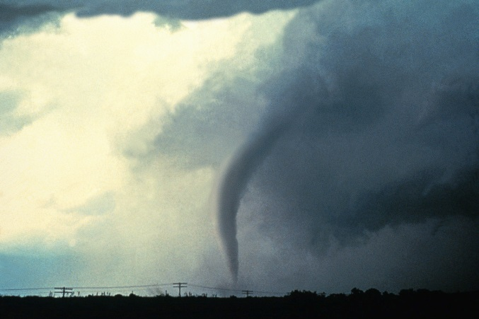
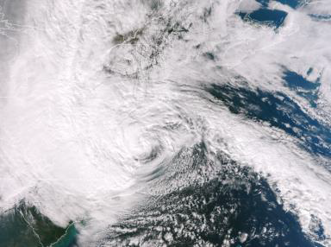
Coordination During Crisis Events
DIB ASSIST application for employee accountability (Encrypted Communication via PTT and situational awareness).
Part of FirstNet for the first responder community.
Drone operations with the Unmanned Aerial Systems ISAO.
Continuity of Operations (COOP) support.
Active support for Critical Infrastructure Partners.
Agreement with ALDOT for drone operations.
NOAA Weather Ready NationTM Ambassador.

Slide 15
Questions?
What did he say?
Why did he take so long?
Could you repeat everything
after “good afternoon”?
Could you talk a little longer?
Still catching up on emails.

Slide 16

Contact Info
Steve Lines
steve.lines@dibisac.net
256.929.8987
Chad Tillman
Chad.tillman@dibisac.net
256.508.3740
256-824-0665 Office
www.dibisac.net
www.uasisao.org
YOU have an obligation to actively participate in the protection of Critical Sector assets from hostile threats and hazards!
Leverage the ISAC communities of trust!

